Slide 1
Autonomous traffic system
Team Hoffenheim
Notes:
Sheikh

Slide 2

Why ?
Problem Statement
Notes:
sheikh

Slide 3
How ?
Concept

Slide 4



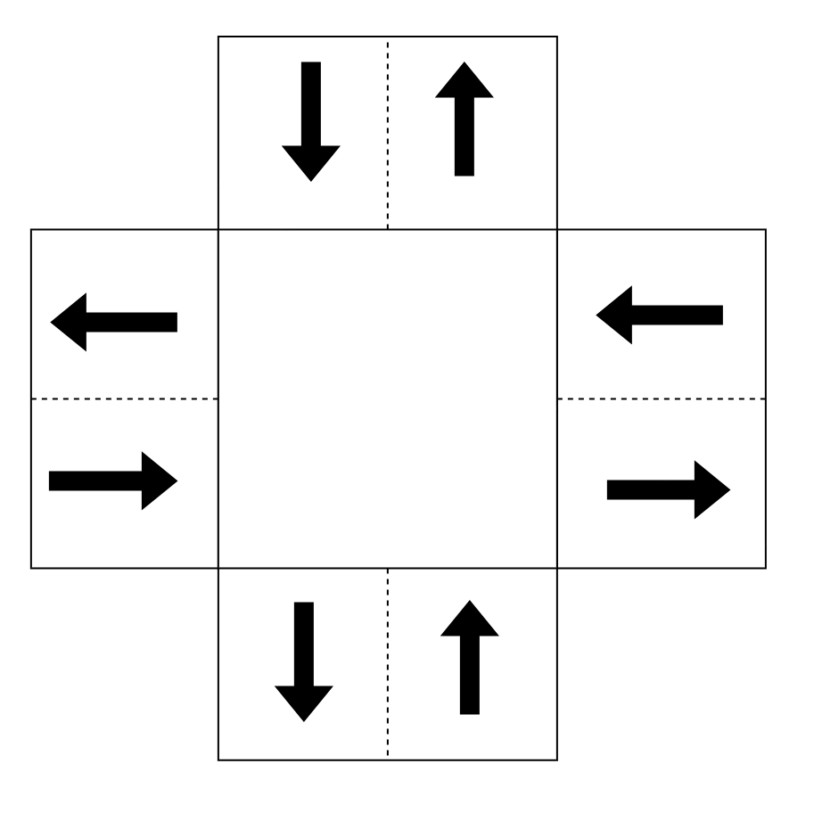
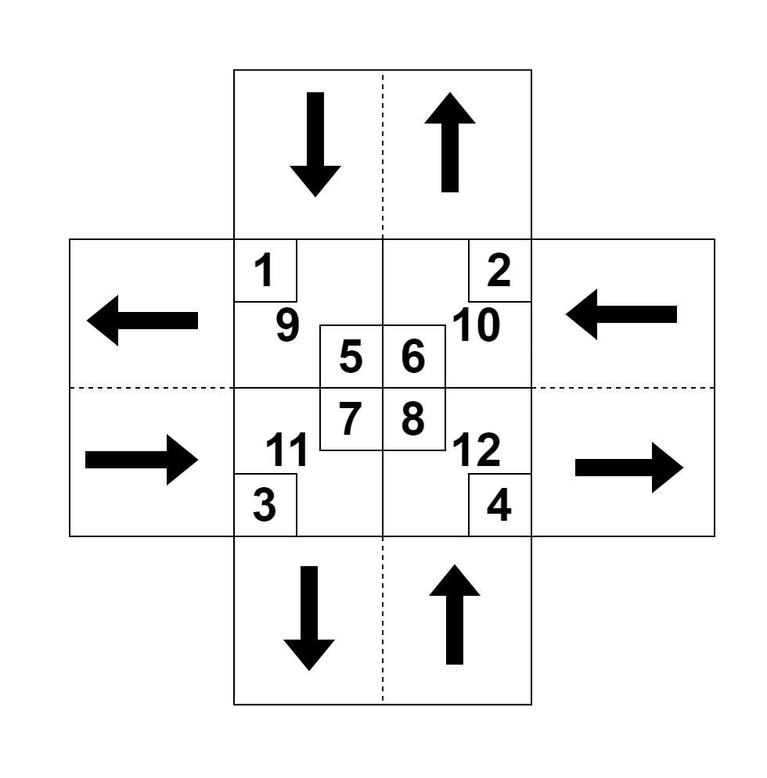

Concept: Centralize System
1
2
3
Request
Manage
Go
Autonomous traffic controller
Autonomous traffic controller

Slide 5
Approach
Approach

Slide 6
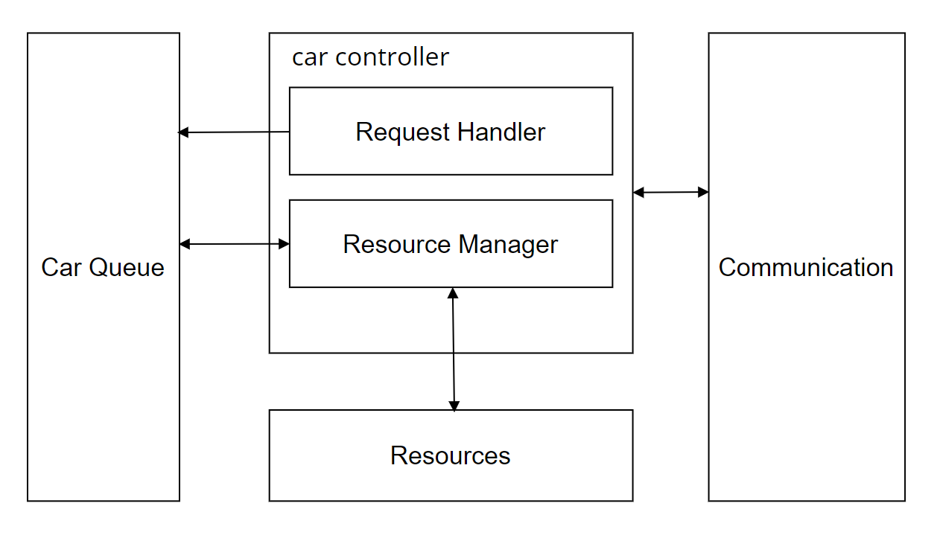
Architecture model
Approach : architectural model

Slide 7
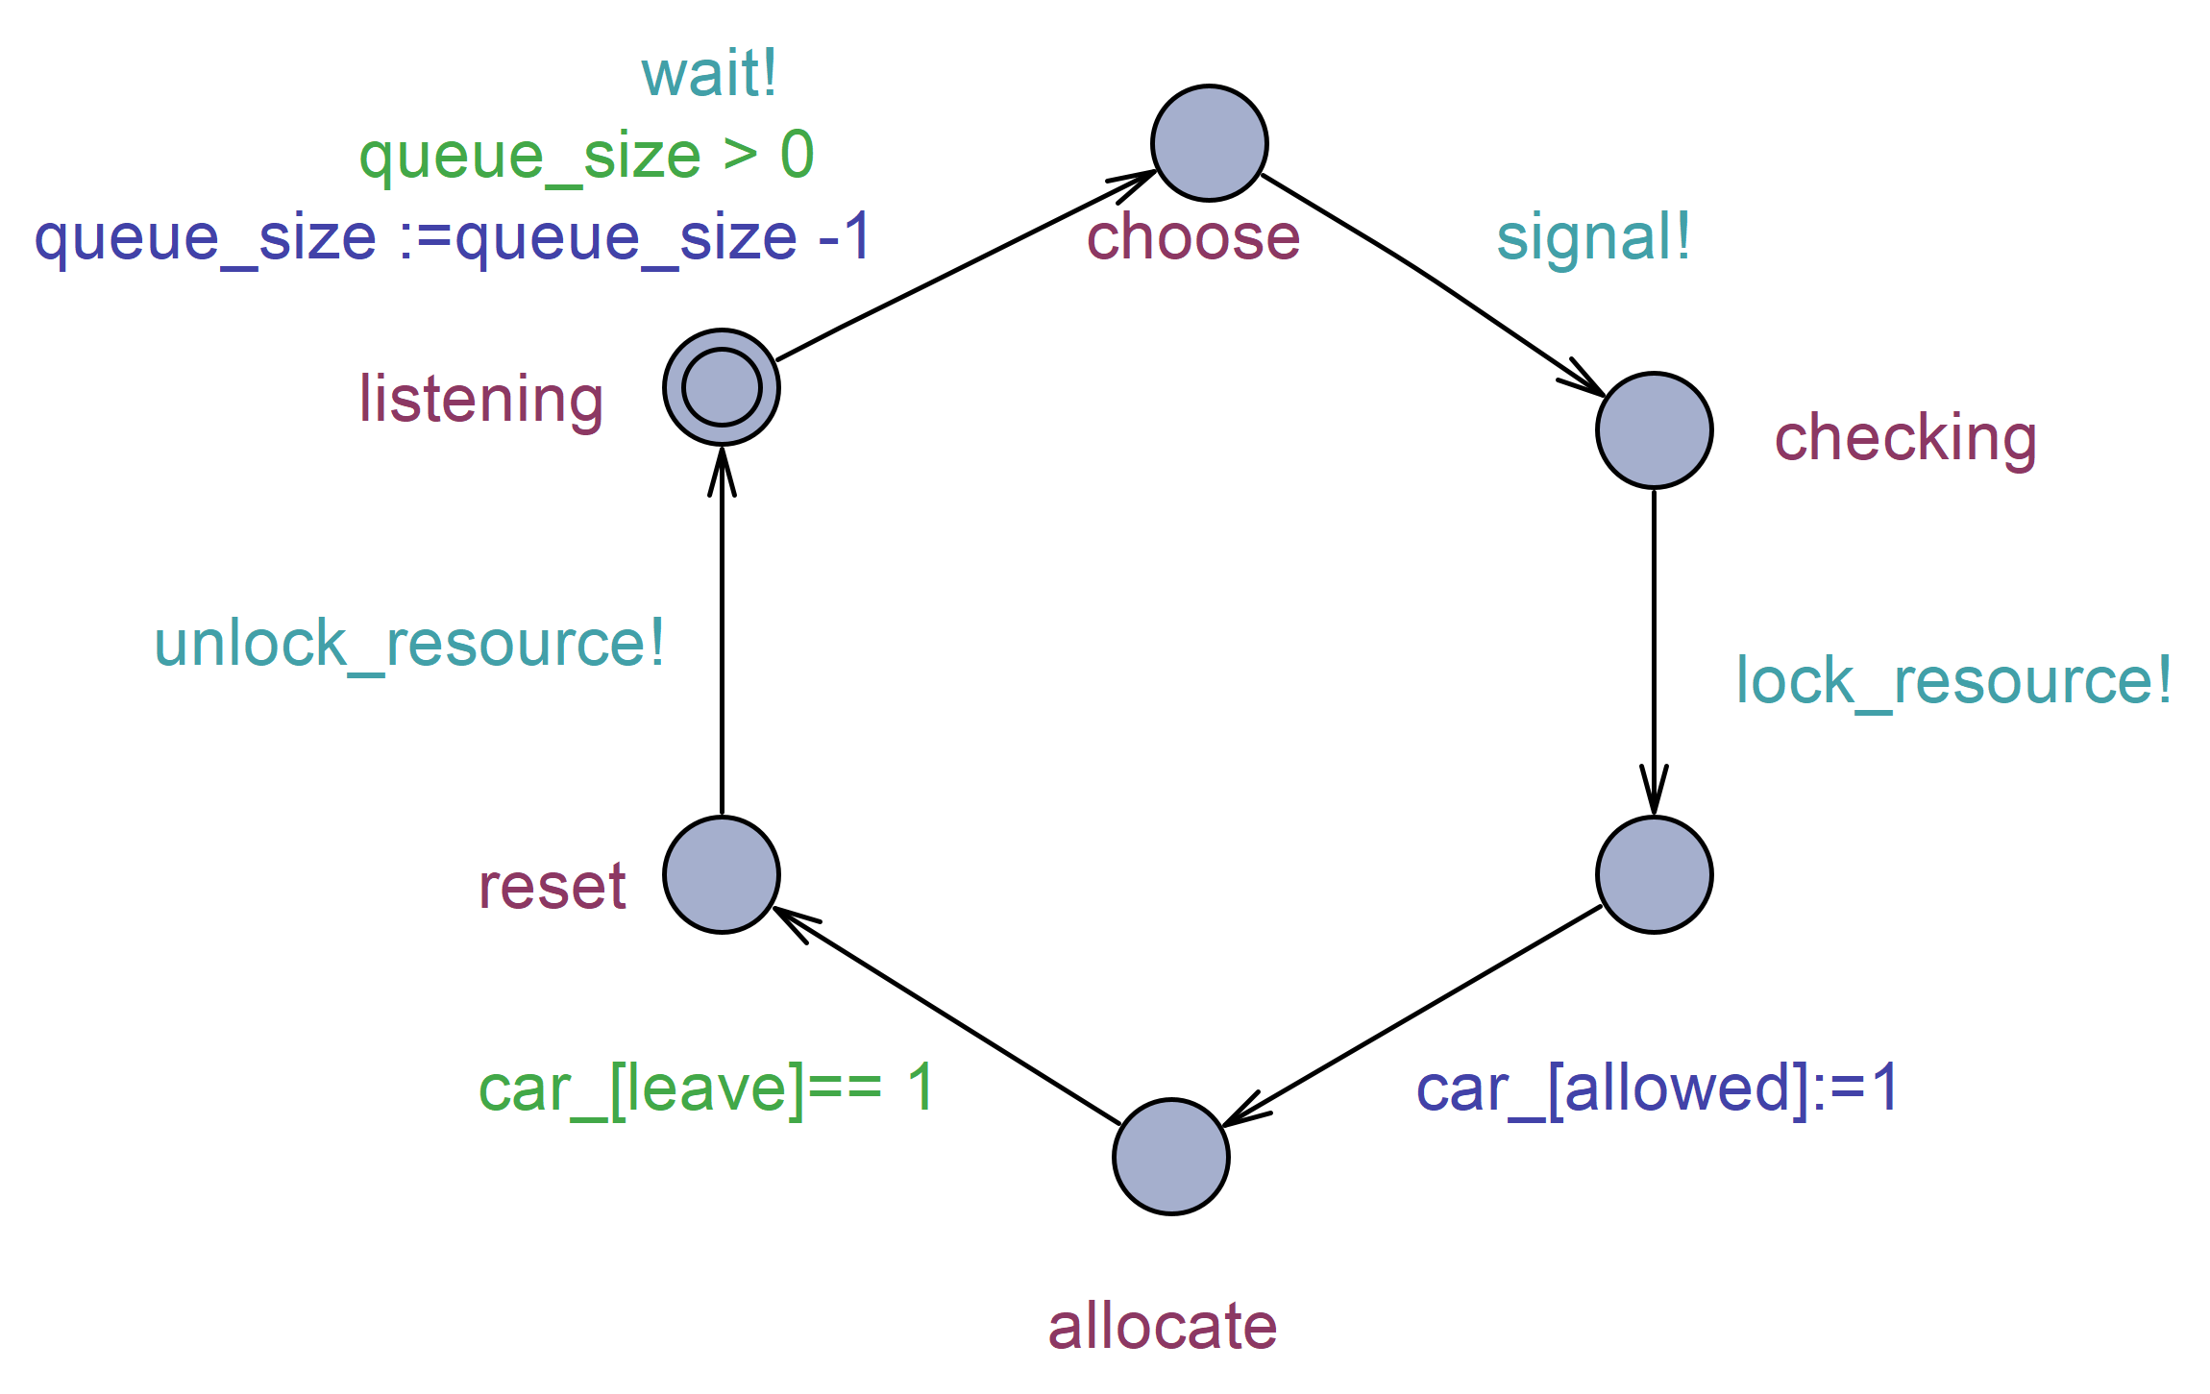
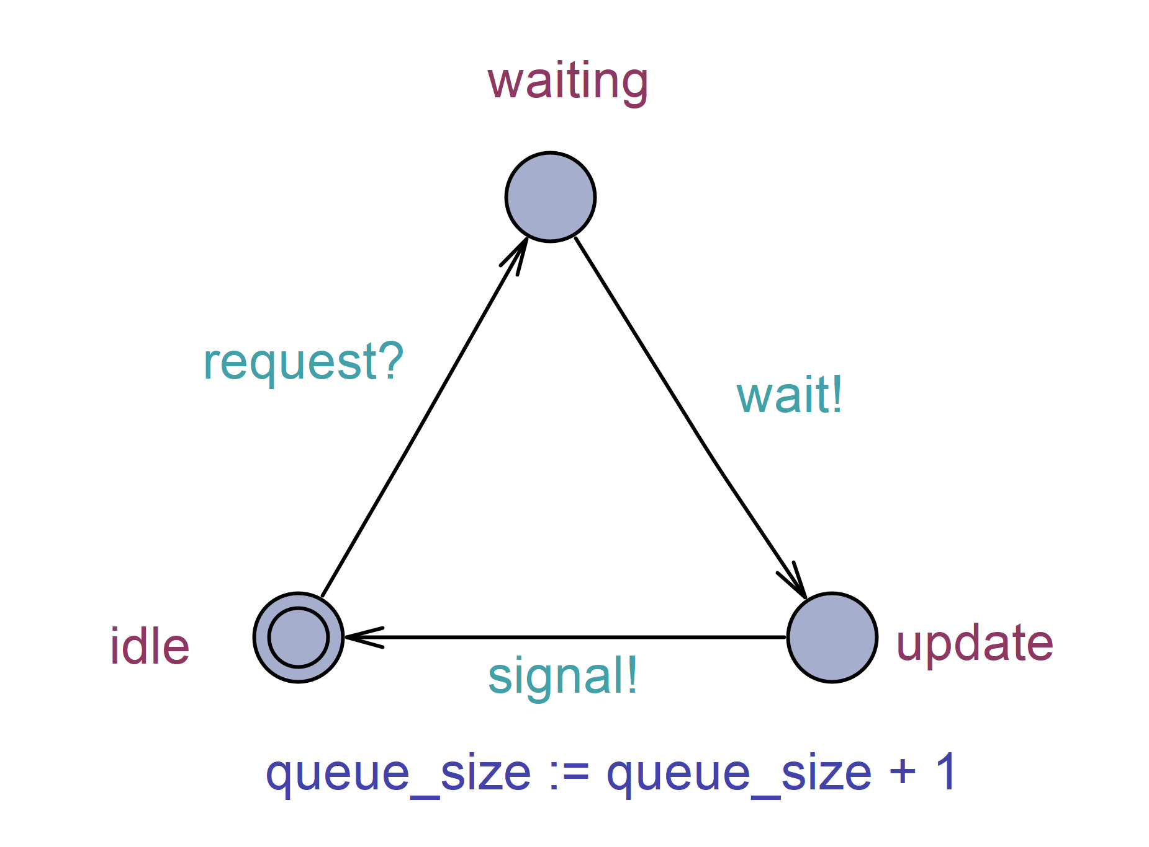
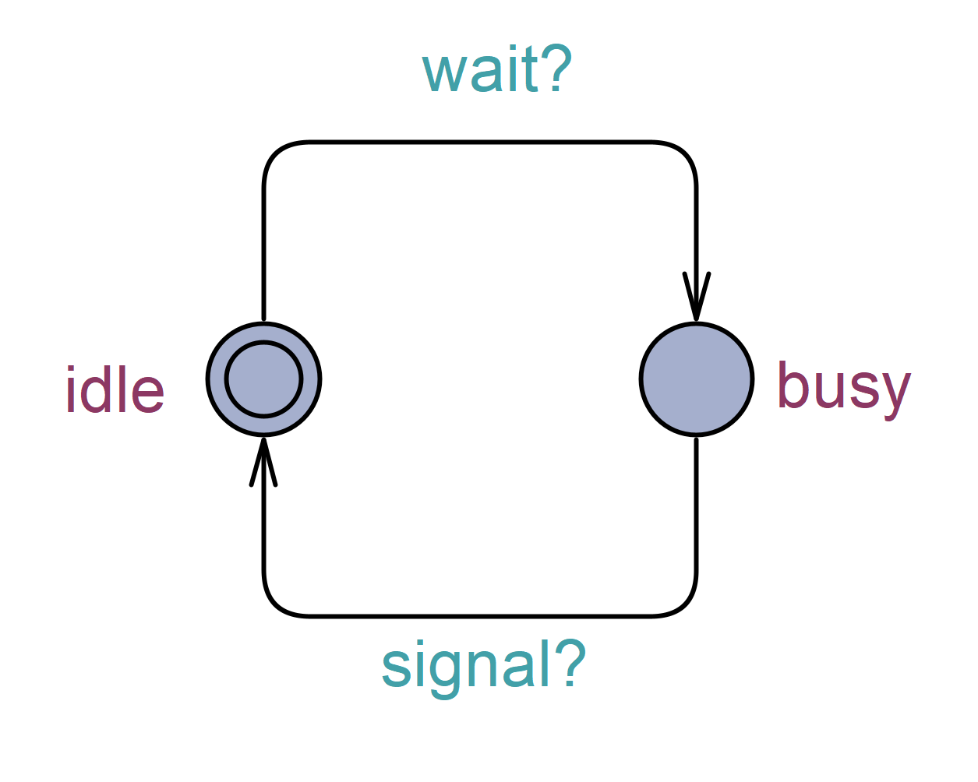
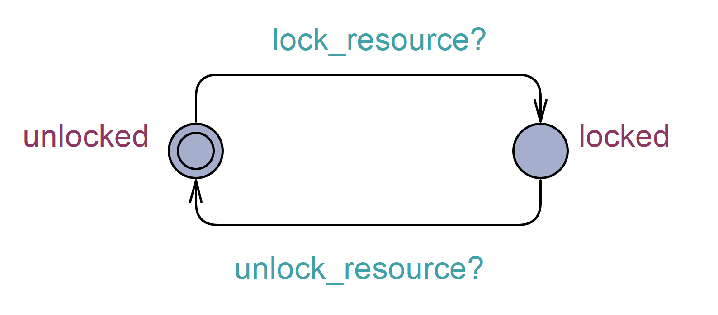
Behavioral model State Chart
Request Handler
Approach : Behavioural model
Resource Manager
Resource
Queue

Slide 8
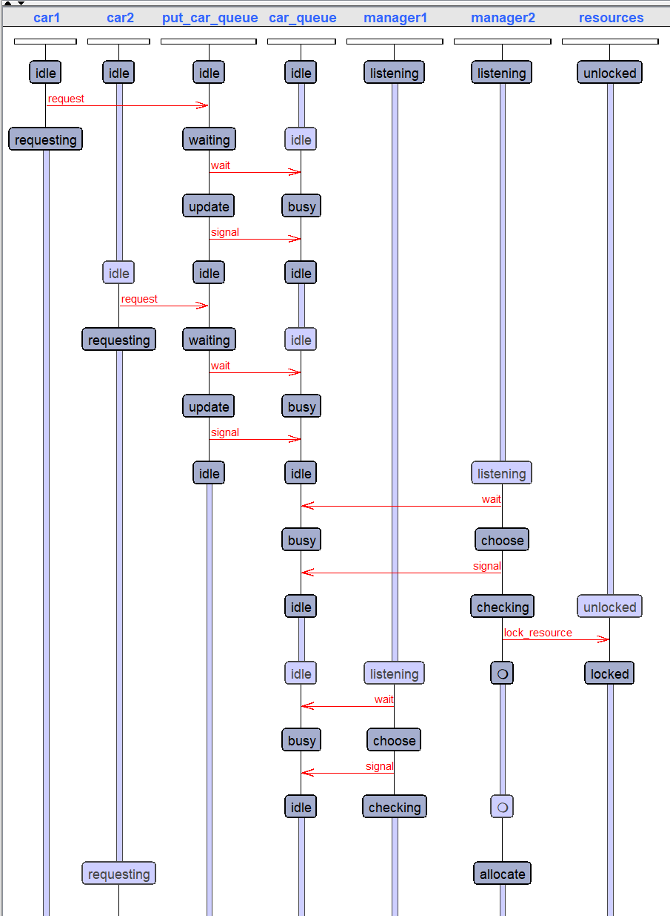
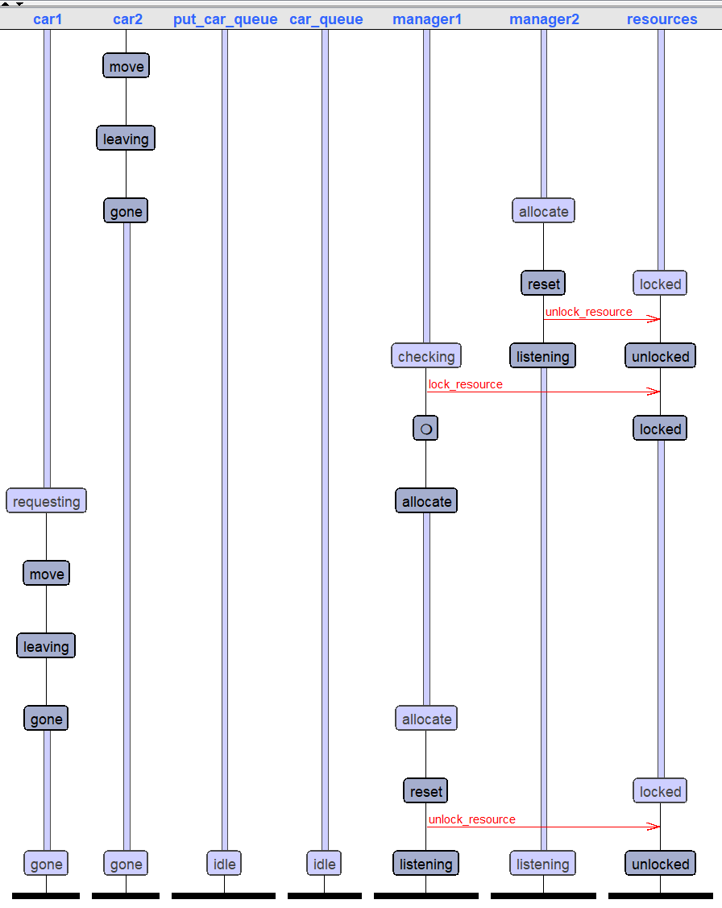
State Chart Simulation
Approach : Behavioural model

Slide 9
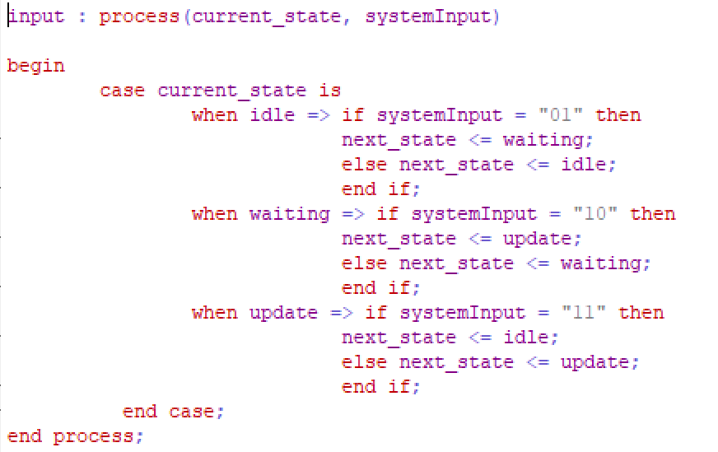
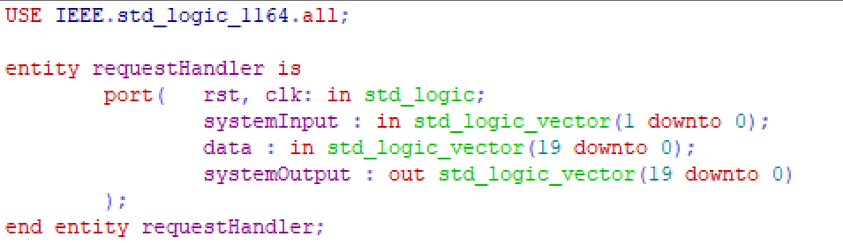
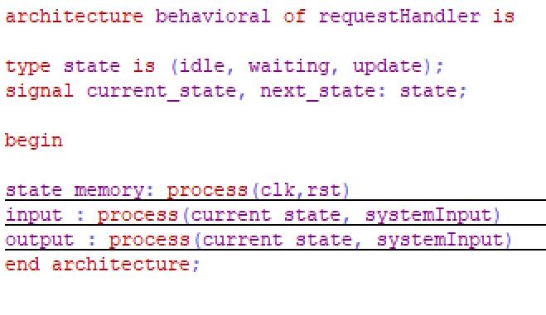
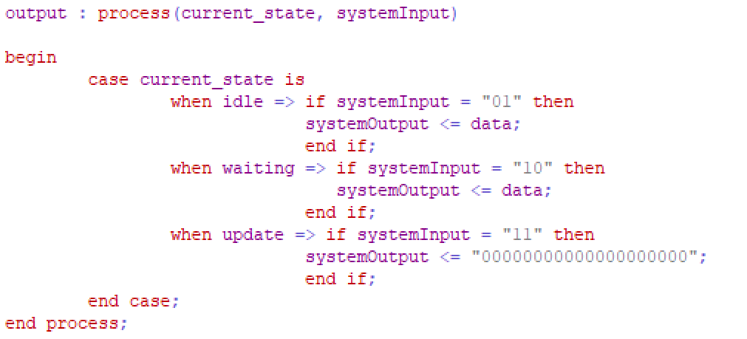
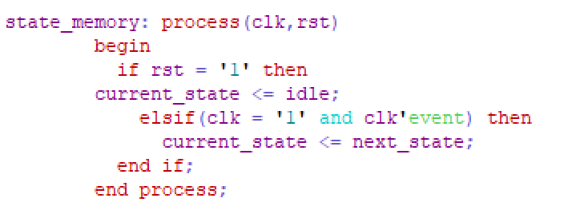
Behavioral model VHDL
Approach : Behavioural model

Slide 10
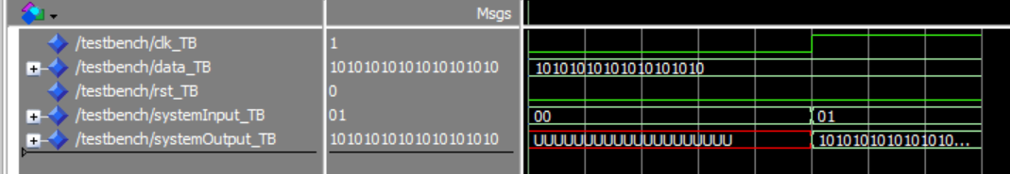
VHDL Simulation
Approach : Behavioural model

Slide 11
The Prototype
Implementation

Slide 12
RTOS on Arduino
Process
Memory
Request Handler
Resource Mananger
Resource Mananger
Resource Mananger
Implementation
Queue
Resource

Slide 13
Simulation
Process
Memory
Request Handler
Resource Manager
Resource Manager
Resource Manager
Requesting car
Implementation
Queue
Resource

Slide 14
Project Management
Scrum Method
12 cycles
Minimum 2 meetings pre cycle
Sub task distributed Fairly
Project Manangement

Slide 15
Conclusion
RTS help to solve our problem
Advance modelling tools ease our approach to the implementation
Conclusion

Slide 16
Thank you

Slide 17
Reference
All model for simulation can be access here: https://github.com/Adib6637/AutonomusTraficSystemHoffenheim

